Slide 1
A Yang Data Model for VN Operation draft-ietf-teas-actn-vn-yang-06
Young Lee, Dhruv Dhody, Daniele Ceccarelli , Igor Bryskin, Bin Yeong Yoon

Slide 2
VN Yang
Customer
Network
VN
Single node in TE Topology
Native TE Topology
abstract topology
Yang model for Virtual Network (VN) operations
From the point of view of Customer
An abstraction over the TE-Topo and TE-Tunnel
These models are from the point of view of Network
VN is a higher level of abstraction
VN model depends tightly on the topology model!
Use Connectivity Matrices

Slide 3
Recent Changes
Relationship to 5G
In the context of 5G transport application, 5G Traffic Provisioning Manager (TPM) that provides slicing requirements to the transport networks (i.e., MDSC) can be considered as a type of CNC. The ACTN CMI provides the necessary interface functions between 5G and transport networks in order to facilitate dynamic VN creation and its lifecycle management with proper feedback loop for monitoring.
Updated illustration and interactions for Type 1 and Type 2 VN
Yang Model Changes
ltp leaf inside vn-ap - used reference to TE-TOPO (was te-tp-id and thus was configurable)
added references for the imported Yang Model
Clarified how this model is used along side TE-topo connectivity matrix (pointer to JSON examples)

Slide 4
Open Issues
VN Members
Qin asked for clarification in the illustration for Lx in VN-Member L1-L2 etc
VN
Current text says Customer End Point
Can be changed to AP?
Can VN member be set from PE to PE without attaching customer facing access also?
Currently VN Members is from a Source to destination AP
RFC 8453 describes AP as a logical identifier shared between the customer and the operator used to identify an access link. And thus this existed between CE and PE.
Possible solutions
Relax the definition of AP
Use of loopback as an AP
Make AP optional
Recursive use of VN model in MPI that starts with PE

Slide 5
Thanks!

Slide 6
BACKUP!

Slide 7
Related Yang Models
L3SM
Augmented with underlying TE
L2SM
Augmented with underlying TE
L1CSM
Augmented with underlying TE
Service Models
TE Topology
TE Tunnel
VN
TE Models

Slide 8
Node
connectivity-matrices
underlay
primary-path
path-constraints
Optimizations
computed-path-properties
connectivity-matrix [id]
From
underlay
Primary-path
path-constraints
Optimizations
To
tunnel-termination-points
tunnel
ietf-vn
AP
VNAP
VN
VN-Member
From
To
global
Per entry

Slide 9
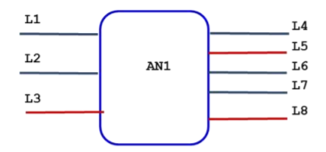

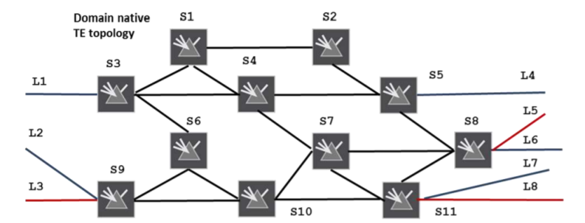
Abstract Topology with a
Single Node
VN Yang Model
AP/VNAP
VN
VN-Member
Connectivity
Matrix
For both VN Type 1 or Type 2 VN Yang model rely on a single node in the abstract TE Topology
The abstract node has
connectivity-matrices
connectivity-matrix [id]
The attributes directly under container connectivity-matrices are the default attributes for all connectivity-matrix entries when the per entry corresponding attribute is not specified. When a per entry attribute is specified, it overrides the corresponding attribute directly under the container connectivity-matrices.
Underlay

Slide 10
VN Type 1
VN is seen as edge to edge links (VN-members) setup as tunnels across underlying networks!
Abstract Topology with a
Single Node
VN 1
VN-Member 1 L1-L4
VN-Member 2 L1-L7
VN-Member 3 L2-L4
VN-Member 4 L3-L8
This VN has following properties
Bandwidth 500
Optimize by delay
connectivity-matrices
Attributes
These properties
are set in TE Topo
14: L1-L4 | 17: L1-L7
24: L2-L4 | 38: L3-L8
Connectivity
Matrix

Slide 11
VN Type 2
Abstract Topology with a
Single Node
VN is seems as a topology of virtual nodes and links
To ease mapping between VN Yang Model and TE models, an abstract single node topology is created with VN topology as the underlay!
The same mapping as VN Type 1 is reused.
VN 2
VN-Member 1: L1-L8 via S3, S67110, S11
Set via the underlay path in connectivity-matrix[id]
Underlay
VN Topology
S3
S124
S5
S8
S9
S67110
S11
Underlay

Slide 12
How: Reference to TE Topology Yang Model
Access | AP/ VNAP -> LTP Ltp of type te-types:te-tp-id
Customer’s Virtual Network | VN -> Abstract Node vn-topology-id of type te-types:te-topology-id abstract-node -> /nw:networks/network/node/tet:te-node-id (reference)
Customer Site to Site connection | VN-Member -> Entry in the connectivity matrix of the abstract node connectivity-matrix-id -> /nw:networks/network/node/tet:te/te- node-attributes/connectivity-matrices/connectivity-matrix/id (reference)
All parameters which are can be set as global attributes to VN are set in the connectivity-matrices (such as bandwidth) and an attribute for a particular VN-member is set in the connectivity-matrix [id] (such as explicit path)!
Duplicate parameters in VN Yang model are removed!

